Slide 1

Project No. : p132
Group No : 06
Date:- 01st Aug 2022
A
PROJECT PRESENTATION
ON
STOCK MARKET FORECASTING
TATA MOTORS LTD.

Slide 2
Group Members
Contribution in Project Work
Anjali Kale
Mizna Patel
Aditya Gawade
Karan Sonpure
Pratik Gade
Shubham Dhavan
Yashraj Dalwe
Mentor:- Mr. Ritesh Maury
Anjali Kale & Mizna Patel : Data Collection (from yfinance)
Aditya Gawade : Sourced different data visualizations (plotly)
Karan Sonpure : Performed initial EDA
Pratik Gade : Implementation of LSTM
Shubham Dhavan : Model Execution
Yashraj Dalwe : Model Deployment

Slide 3
Objective :
Data science approach to stock prices forecasting & prediction of TATA MOTORS Ltd. stock using Long Short-Term Memory (LSTM) model.
Introduction :
Stock market prediction is the act of trying to determine the future value of company stock or other financial instruments traded on an exchange. The successful prediction of a stock’s future price could yield a significant profit. In this application, we used the LSTM network to predict the next single day as well as next 10 days closing stock price using the past 10 years stock prices. We have imported few libraries for stock market forecasting and they are namely as : pandas,numpy,matplotlib,plotly,datetime to get stock information & data visualization purpose.
What is Time-Series?
Time Series comprises of observations that are captured at regular intervals. Time Series datasets have a strong temporal dependence. It can be used to forecast future observations based on previous ones.

Slide 4

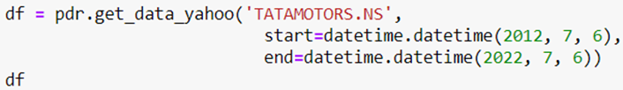
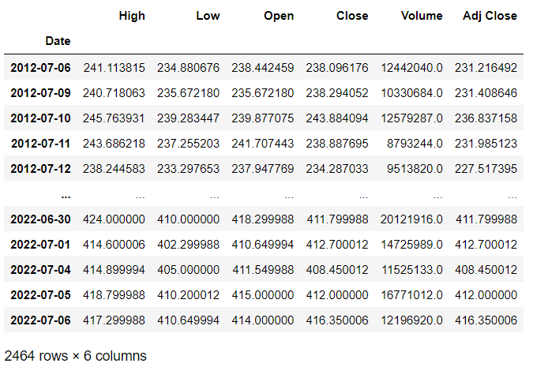
Dataset Source :
Collected data from yfinace.com for the past 10 years for stock prediction.
Import Dataset
View of Dataset

Slide 5
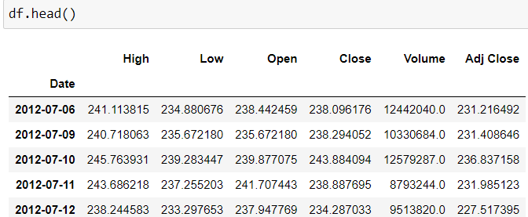
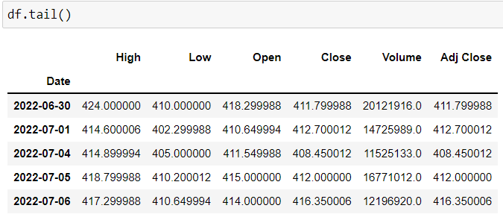
Exploring the data/Loading and Preparation of Data:
Description of each attribute
Date: — Trading date of the stock.
Open: — Stock’s opening price
High: — Highest price of the stock on a particular trading day.
Low: — Lowest stock price during trade day.
Close: — Closing price of the stock during trade-in particular day.
Volume: — This is the number of stocks traded on a particular day.
Adj Close: — This is the ending or closing price of the stock which was changed to contain any corporations’ actions and distribution that is occurred during trade time of the day.

Slide 6

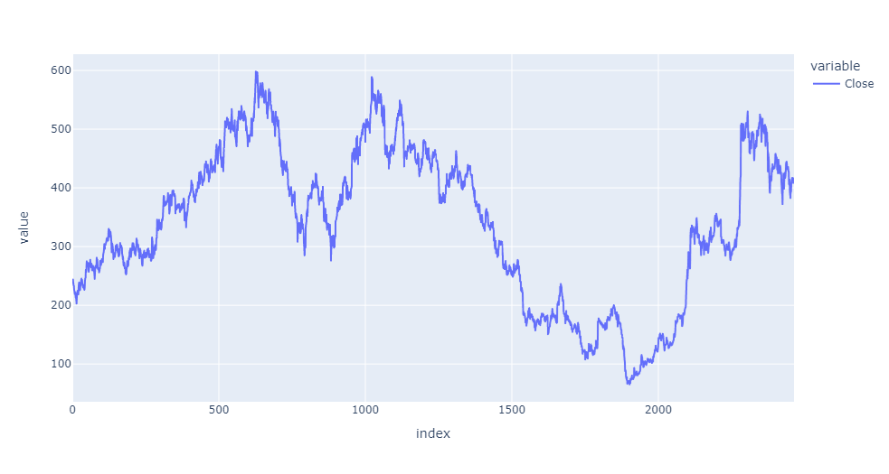
[Close] Column Time Series Graph using plotly :
Visualizing the stock data

Slide 7
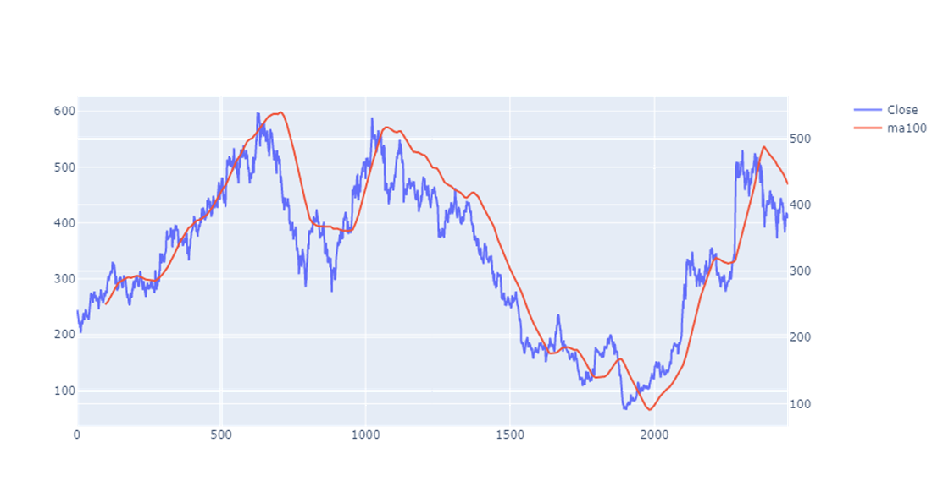
[Close] Column Graph of Moving Average 100 Days
Visualizing the stock data

Slide 8
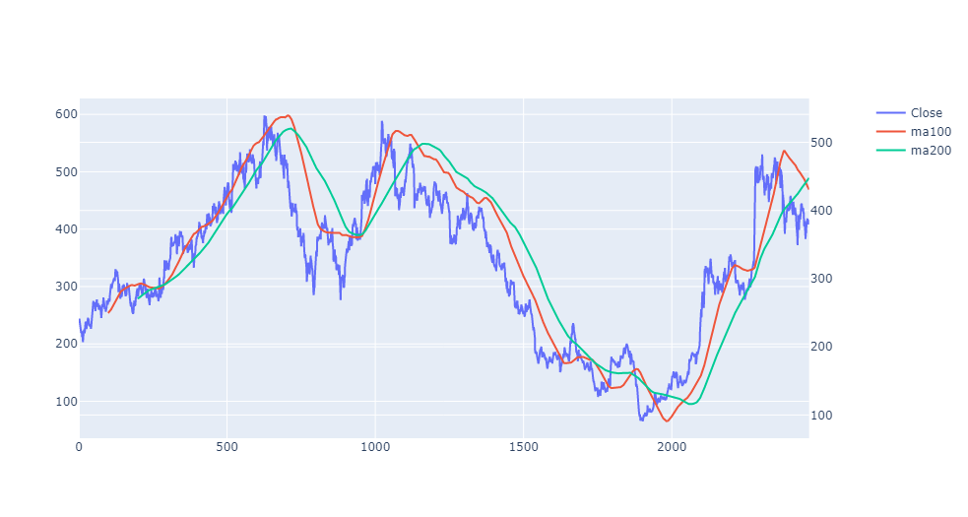
[Close] Column Graph of Moving Average 100 & 200 Days
Visualizing the stock data
Remark:- When green line crosses red line sudden downfall & up fall happens and it has observed in above plot.

Slide 9
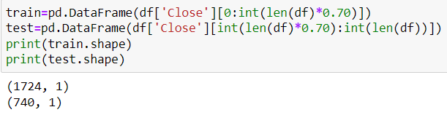
Creating a New Data frame & Splitting of Data
Train Data
Test Data
Here we created data set & splitted into train & test containing the closing price of past10 years,
So that, we could examine the prediction for the single day as well as next 10 days closing price.

Slide 10
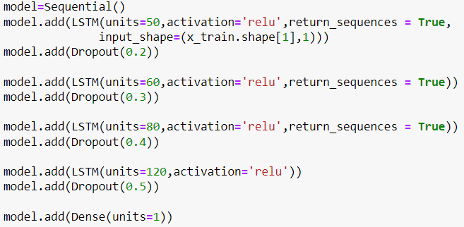
Building the LSTM :
In order to build the LSTM, we need to import a couple of modules from Keras:
1. Sequential for initializing the neural network
2. Dense for adding a densely connected neural network layer
3. LSTM for adding the Long Short-Term Memory layer
4. Dropout for adding dropout layers that prevent overfitting
For Example:-When defining the Dropout layers, we specify 0.2, meaning that 20% of the layers will be dropped.
Thereafter, we add the Dense layer that specifies the output of 1 unit.

Slide 11
Compiling the Model:
We have compiled model using the adam optimizer and set the loss as the mean_squarred_error. This has computed the mean squared error.
Next, we fitted the model to run on 50 epochs

Slide 12
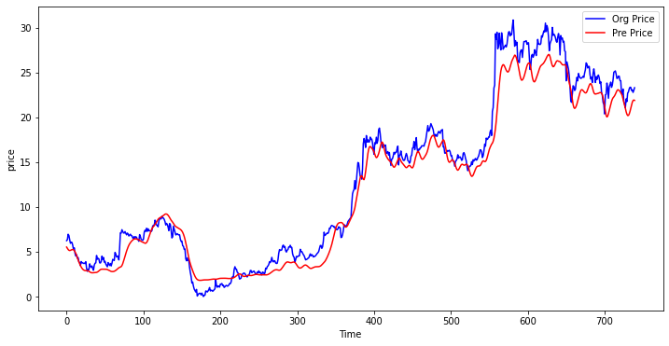
Graph of y_test data:

Slide 13
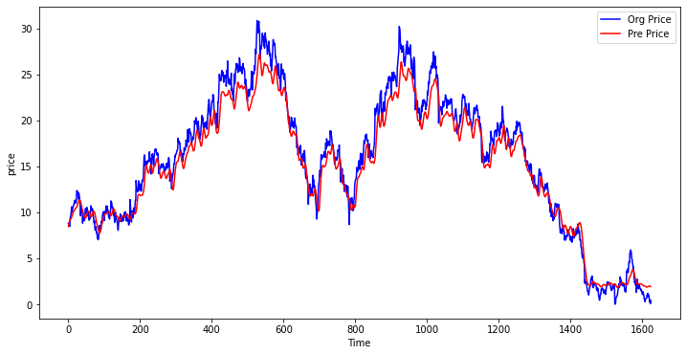
Graph of y_train data:

Slide 14
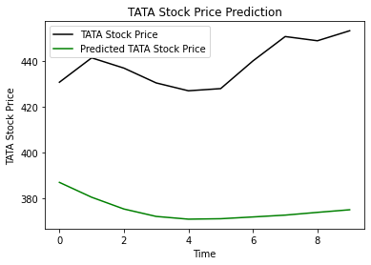
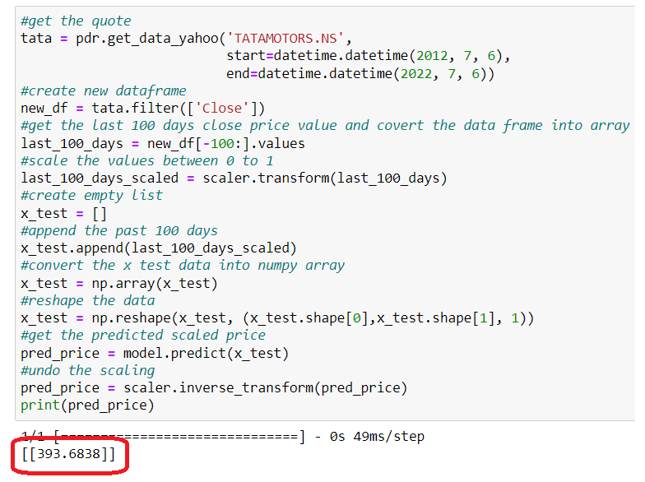
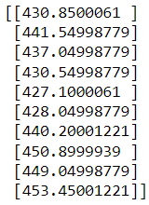
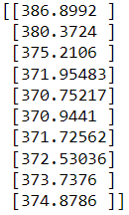
Make Predictions:
Next Single Day
Next 10 Days
Actual [Close] Prices Vs Final Predictions

Slide 15
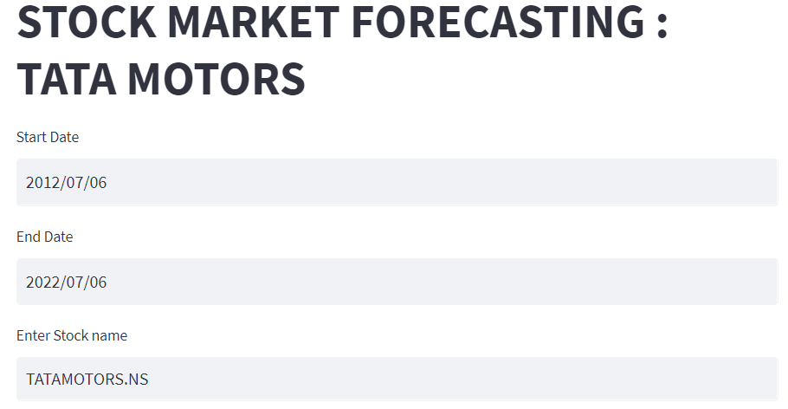
Model Deployment on Web Server :
For model deployment ,we have implemented data on streamlit.
1.Create .py file for streamlit containing all visualization tasks (Import dataset,Name of Stock, Describe
& Plots/Graphs)
2.Open the command prompt
3.Run pip install streamlit
streamlit run filename.py
4.New window will open containing streamlit data
Just for Look

Slide 16
Conclusions :
By implementing the LSTM model with step wise increase in neurons and compiling adam optimizer & assigning loss as mean squared error ,we have achieved optimum results for [Close] price.
Also got minimum RMSE values for train and test data.
Splitted train-test plots are also following the path of actual [Close] column time series plot.
Project GitHub Links of Group Members :
Anjali Kale : https://github.com/anjalikale503/project-on-SM-Forcasting
Mizna Patel : https://github.com/Miznapatel/SM-forecasting
Aditya Gawade : https://github.com/adu7131/Project-data
Karan Sonpure : https://github.com/Karansonpure/Project-data
Pratik Gade : https://github.com/pratikgade49/Project-on-SM-Forcasting
Shubham Dhavan : https://github.com/ShubhamDhavan/Stock-Market-Forecasting
Yashraj Dalwe : https://github.com/DalweYashraj/Data-Science-Projects

Slide 17
THANK YOU

